Slide 1
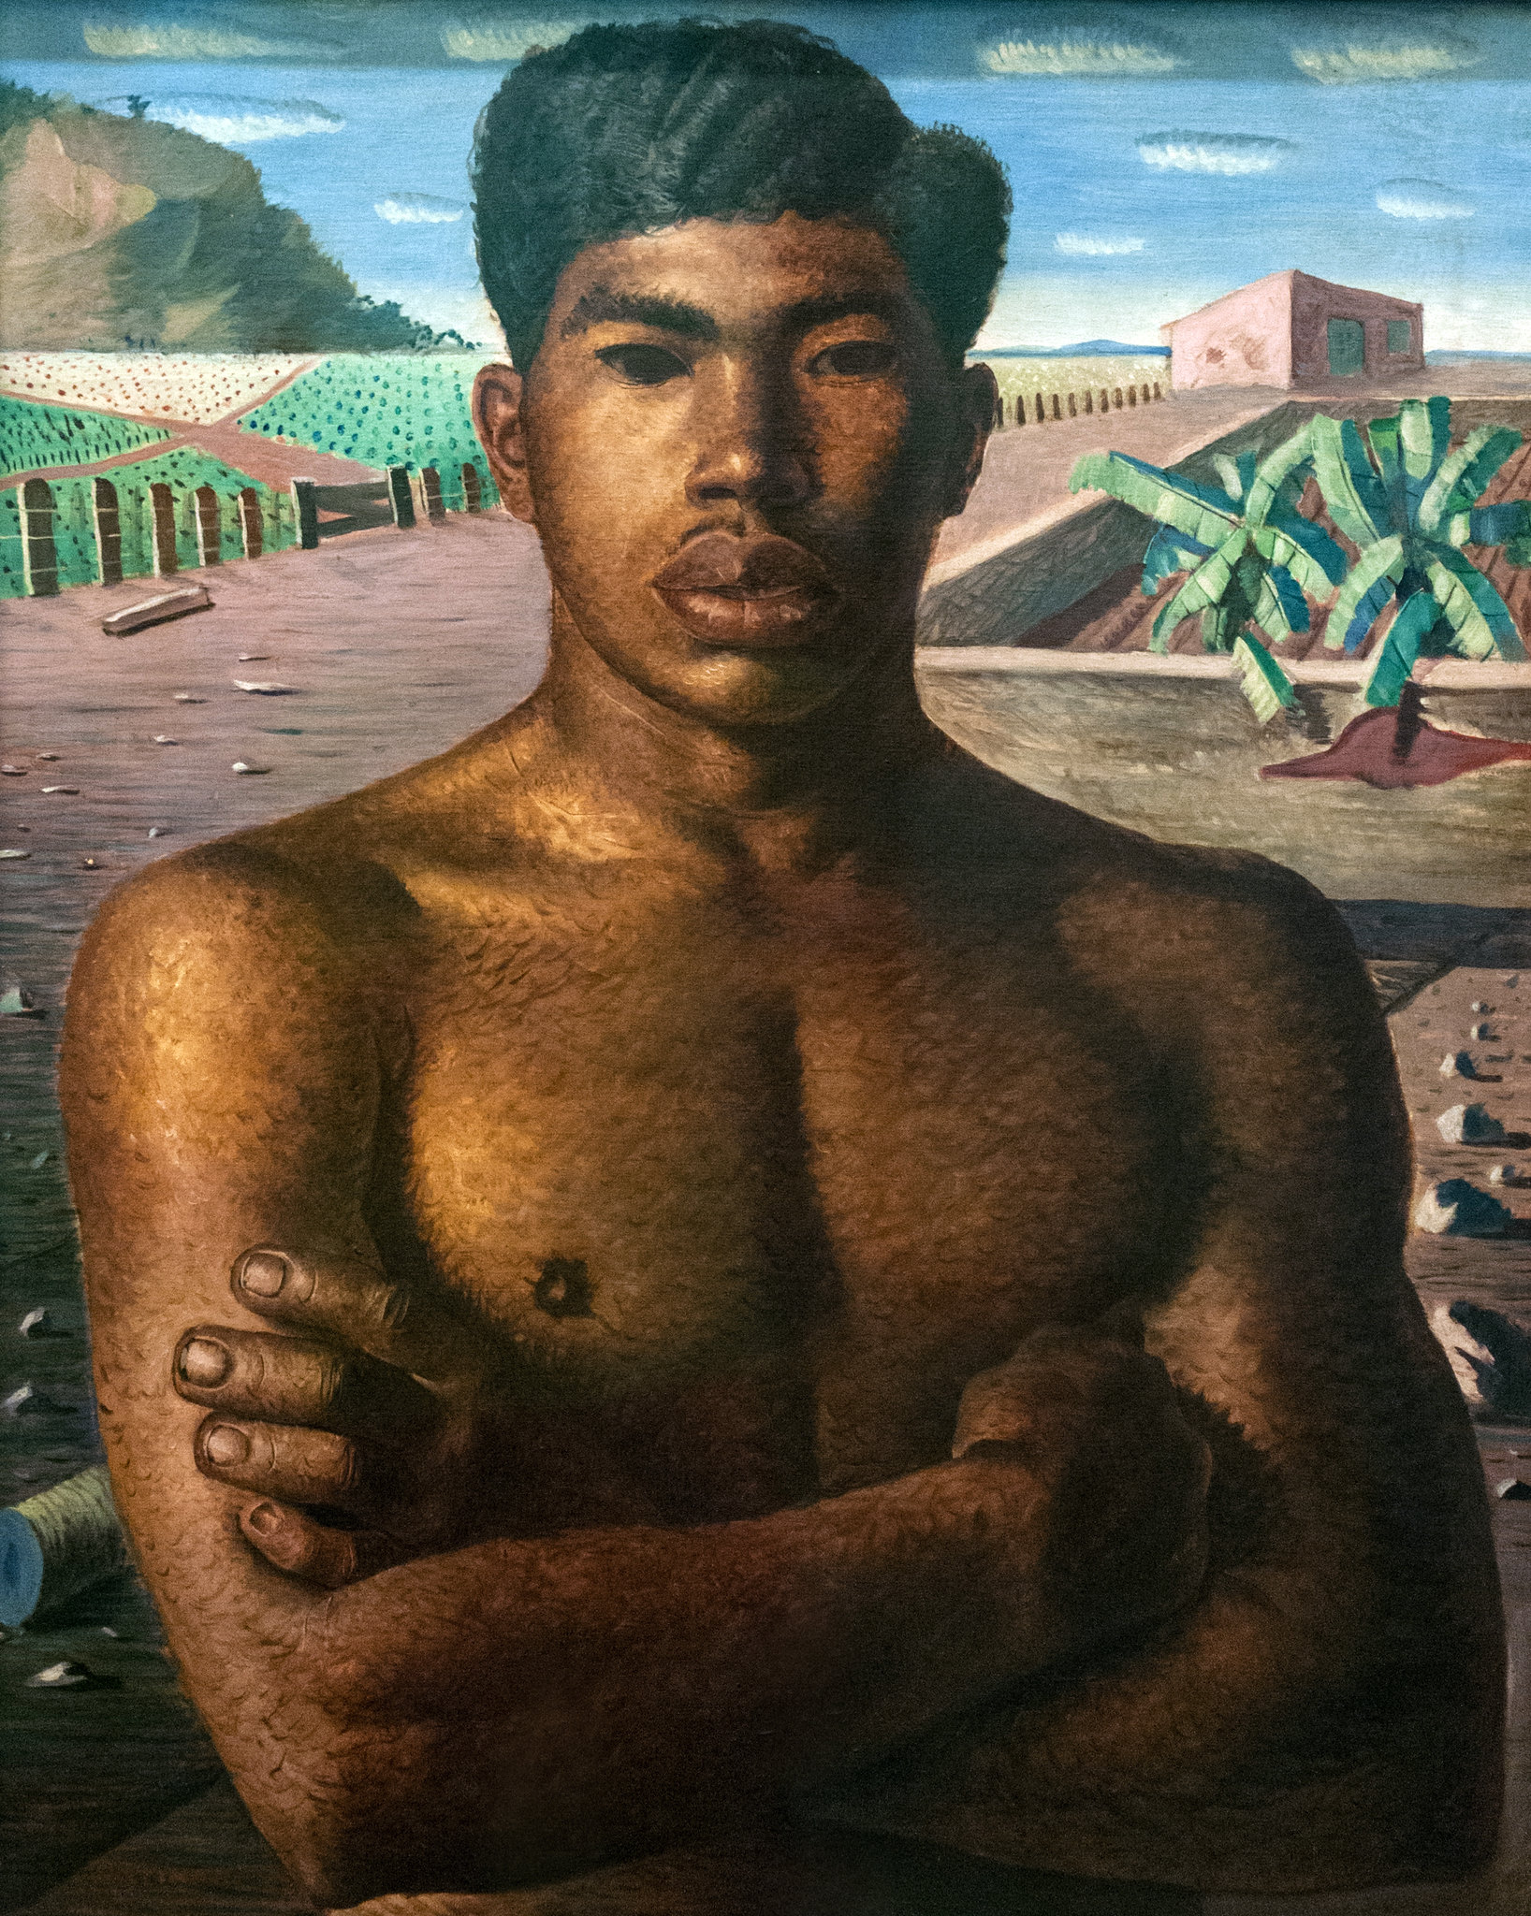
Mestiço 1934 Candido Portinari

Slide 2
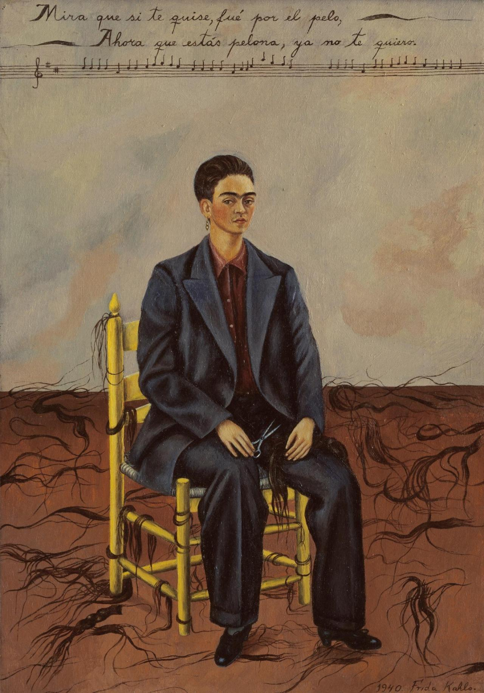
Pelona
(Frida Kahlo. Self Portrait with Cropped Hair.1940 - MoMA)

Slide 3
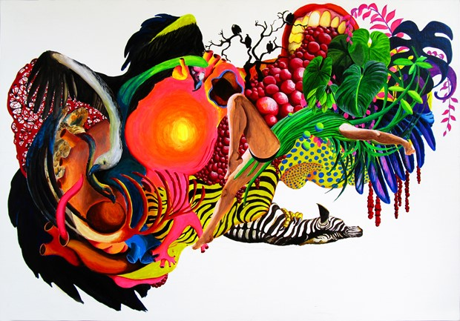
Karin Janssen /
www.karinjanssen.com

Slide 4
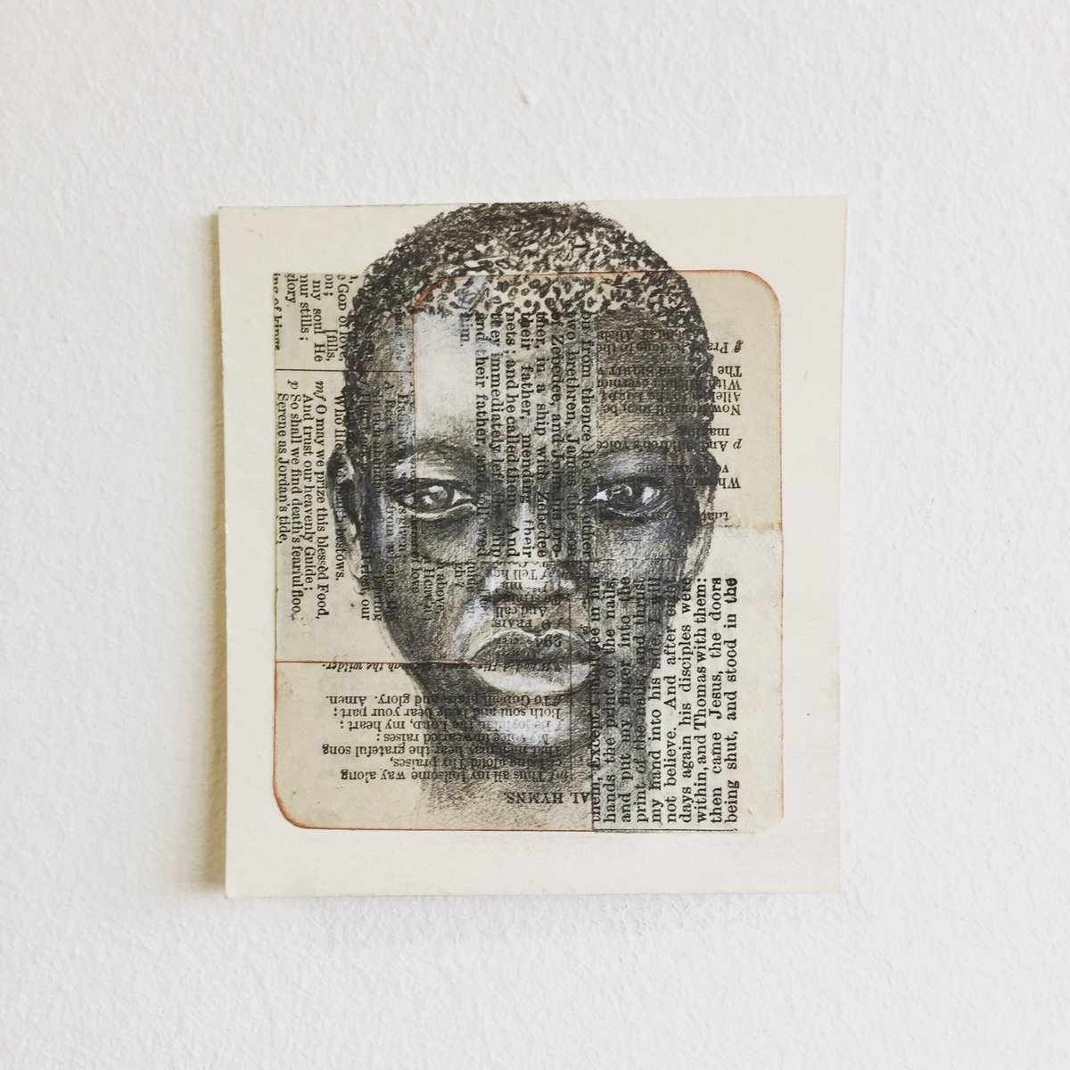
Joyce Treasure
Multidisciplinary Artist
https://joycetreasure.co.uk

Slide 5
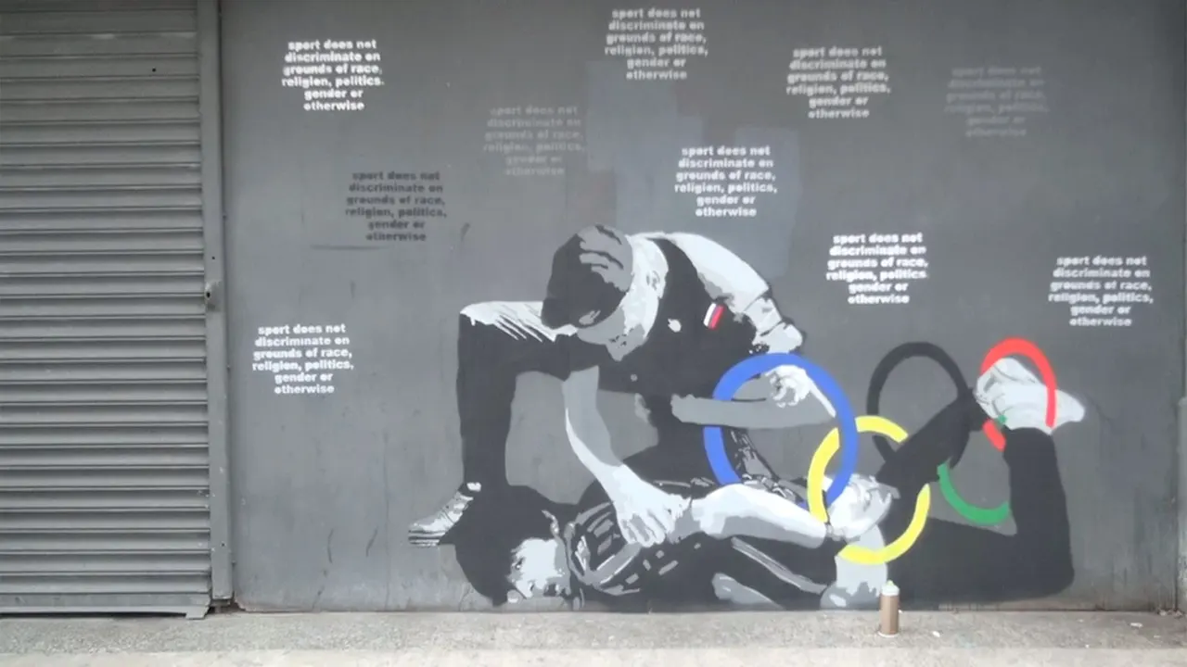
Ida4 ( Chris Fleming)
https://www.theguardian.com/world/video/2014/feb/07/sochi-winter-olympics-street-art-protest-russia-anti-gay-laws-video

Slide 6
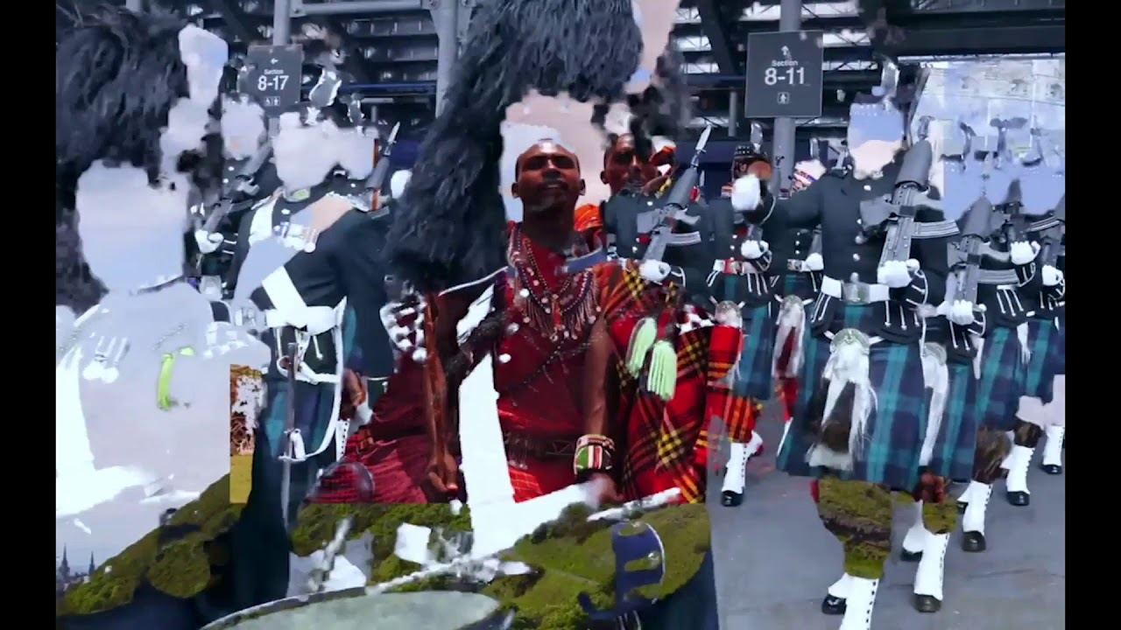
Natasha Thembiso Ruwona
“What is it we choose to remember about the past and what is it we will choose to forget?
Saidiya Hartman

Slide 7
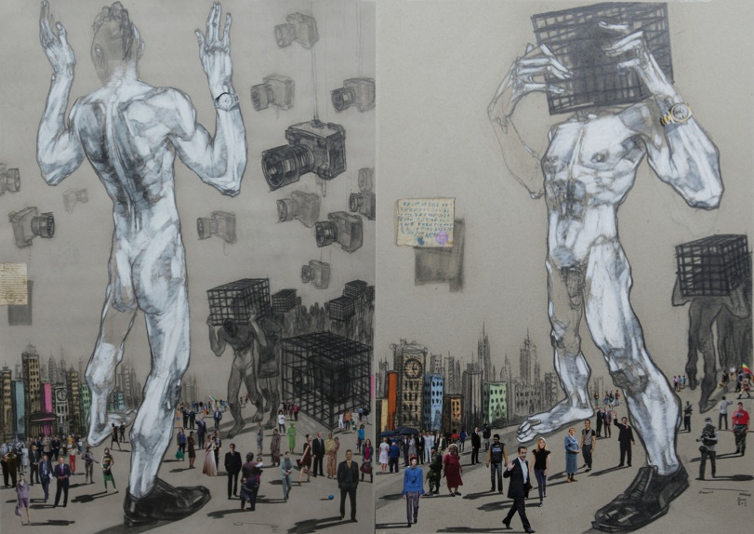
Mutual Identity by Dawit Abebe
Kristin Hjellegjerde Gallery
https://kristinhjellegjerde.com/

Slide 8
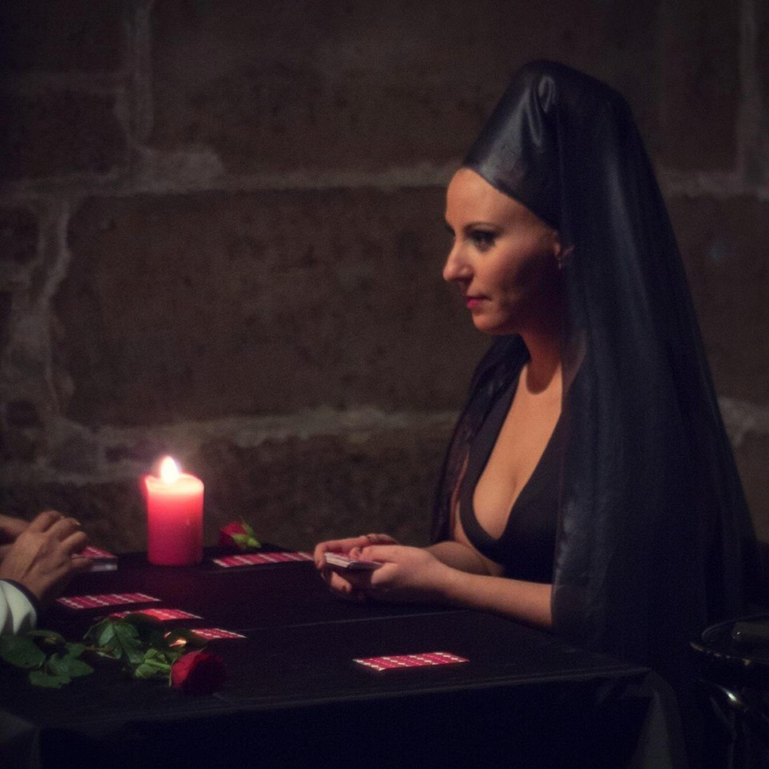
Sarah El Hamed
French-Algerian artist, performer, producer, curator
sarah-elhamed.com

